Slide 1
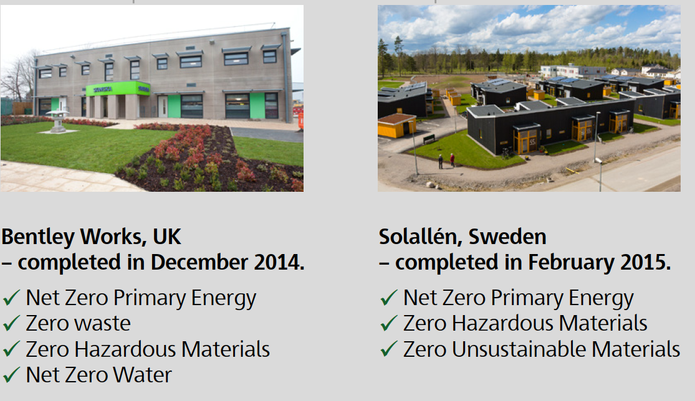
Commercial, Industrial and Residential
Notes:
Solallén is Sweden’s first net zero energy
neighborhood and our first ever net zero
energy and Deep Green residential project. The
Solallén neighborhood includes 21 townhouses
and achieved net zero primary energy, zero
unsustainable materials and zero hazardous
materials.

Slide 2
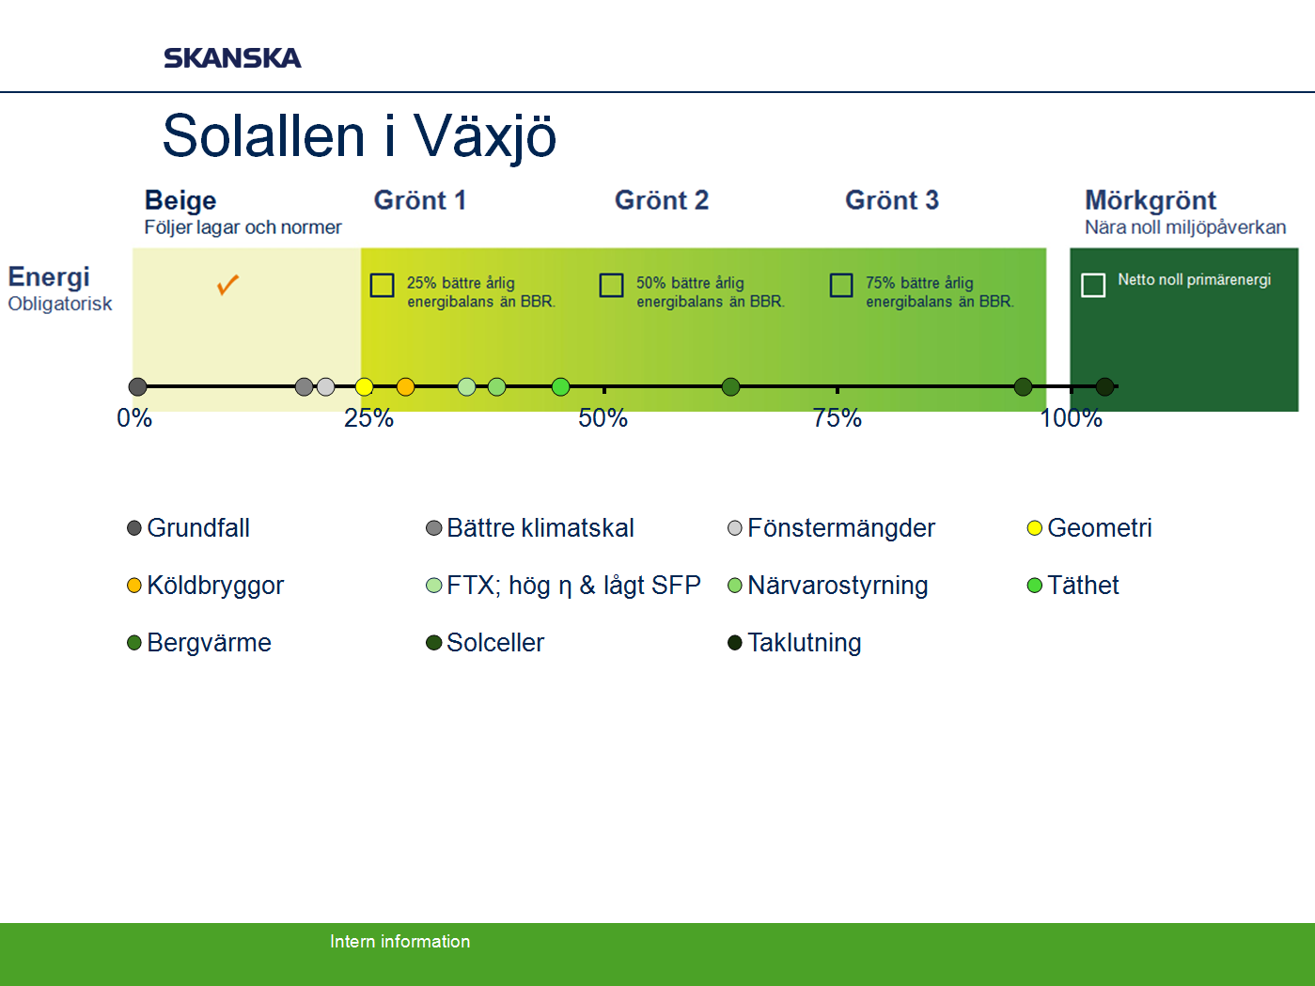
Base case
Insulation
Window areas
Geometry
Thermal bridges
MVHR
Absence control
Air tightness
GSHP
PV Panels
Roof tilt

Slide 3

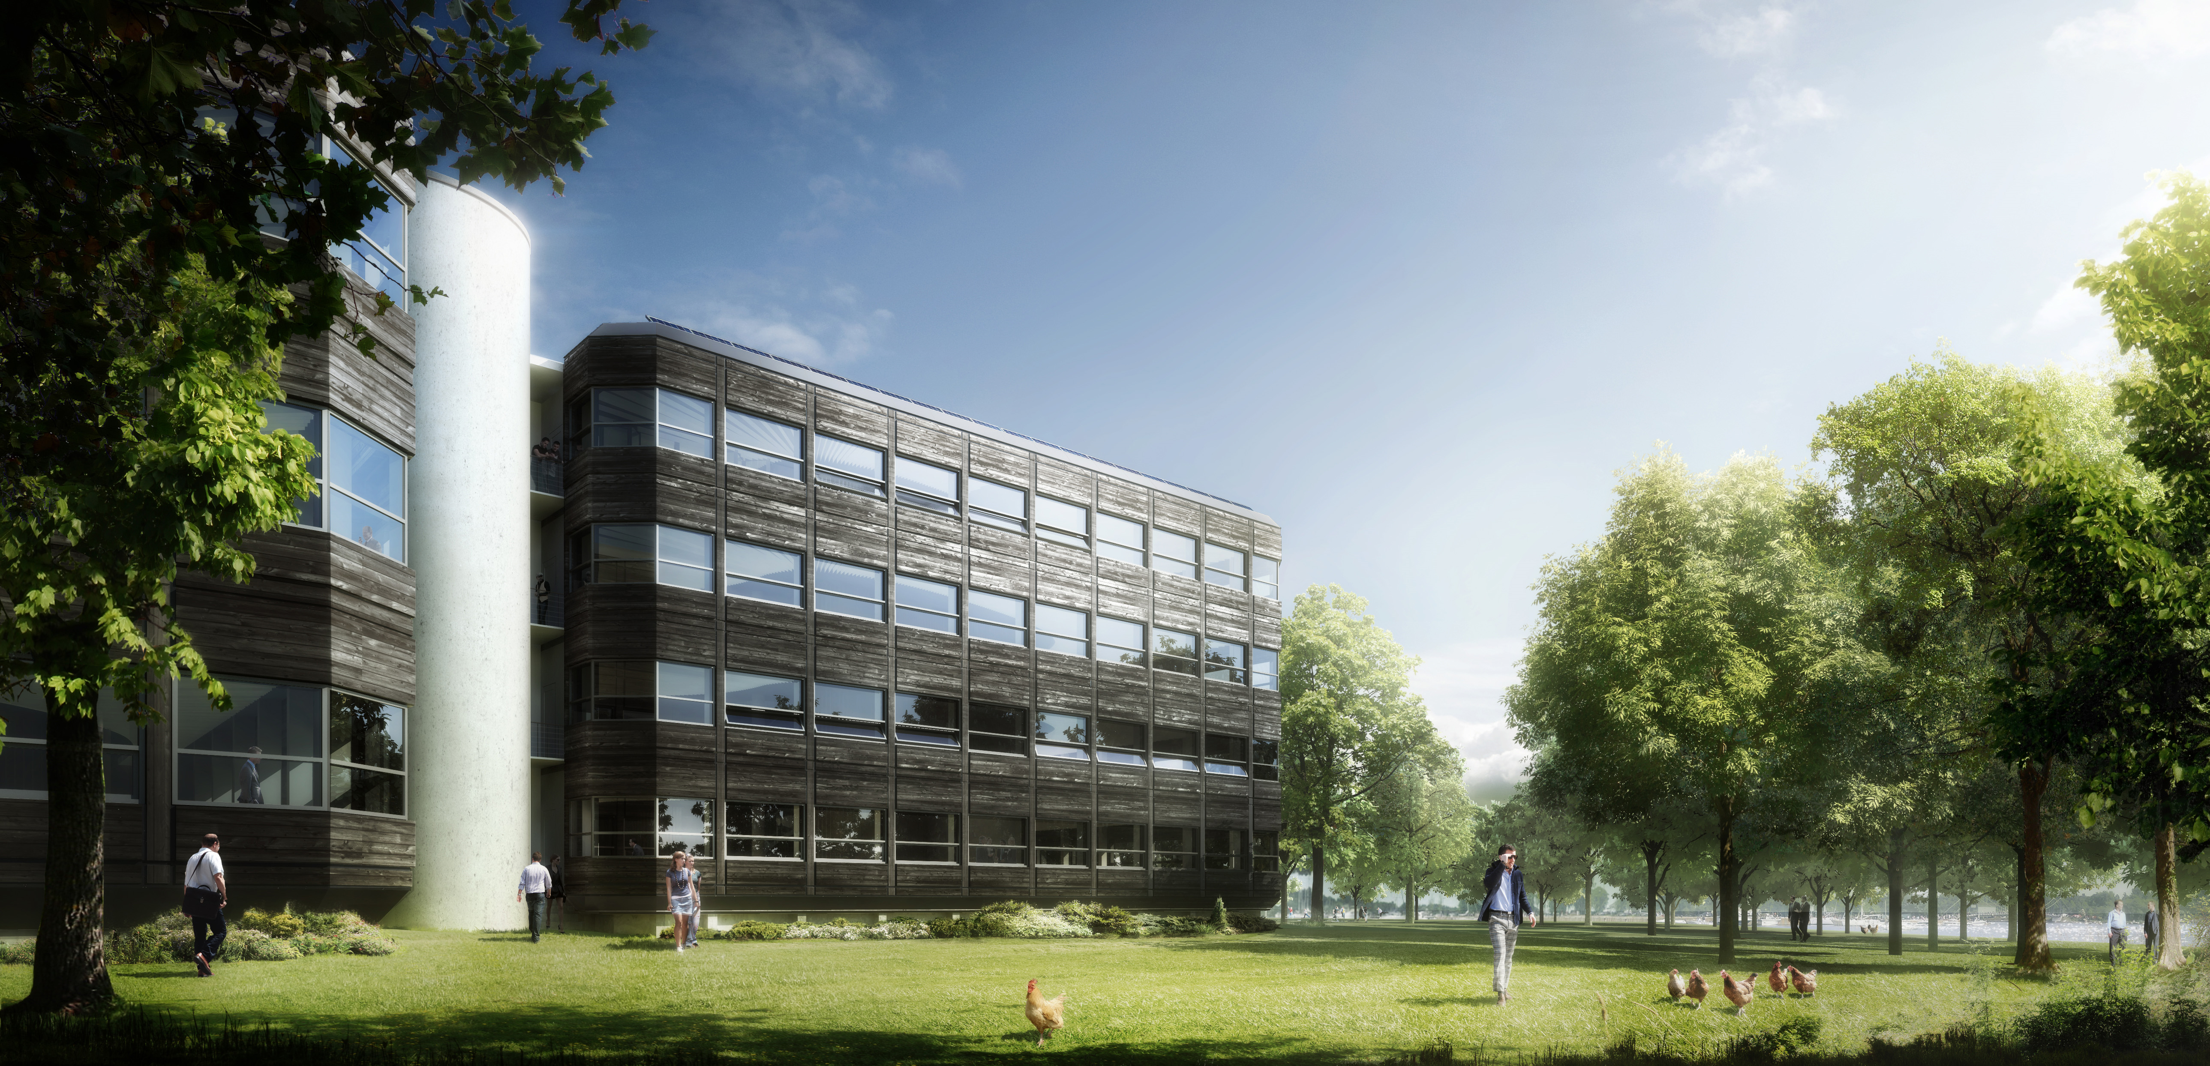
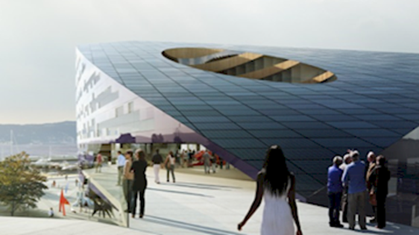
Powerhouse Kjørbo
Brattørkaia in Trondheim
Energy Positive retrofit and new build in the Norway
Entra Eindom, Skanska Snøhetta and ZERO (NGO)
BREEAM- NOR Outstanding
http://www.powerhouse.no/en/
Notes:
Powerhouse is a collaboration of companies dedicated to building energy positive buildings. The collaboration consists of Entra Eiendom, Skanska, Snøhetta, the environmental NGO ZERO, the aluminium extrusion company Sapa og the consulting firm Asplan Viak. We want to demonstrate that it is possible to build energy positive buildings, not just in the southern regions of the world, but also in cold Norway.
Powerhouse has already rehabilitated Powerhouse Kjørbo into an energy positive building, as well as developing a new energy positive office building at Brattørkaia in Trondheim. Entra owns both properties.
Entra is one of Norway's leading real estate companies. We are an Industry leader in developing and managing energy efficient buildings. Our portfolio consists of flexible and environmentally friendly, high-quality office buildings in central locations close to public transportation hubs.
Skanska Norway is a proud member of the Powerhouse consortium, and the entrepreneur behind Powerhouse Kjørbo, an office that is its own power plant.
Powerhouse Kjørbo, outside Oslo, produces twice as much energy as its operation uses. The BREEAM-NOR Outstanding environmentally certified building is probably the world's first refurbished building to be energy-plus.
"Through Powerhouse Kjørbo we are showing that it's possible to construct a building that provides a positive result, not just environmentally, but financially as well. Making a commercial gain is a basic precondition for investing in this type of project in the future," says Klaus-Anders Nysteen, CEO at Entra Eiendom.

